Slide 1
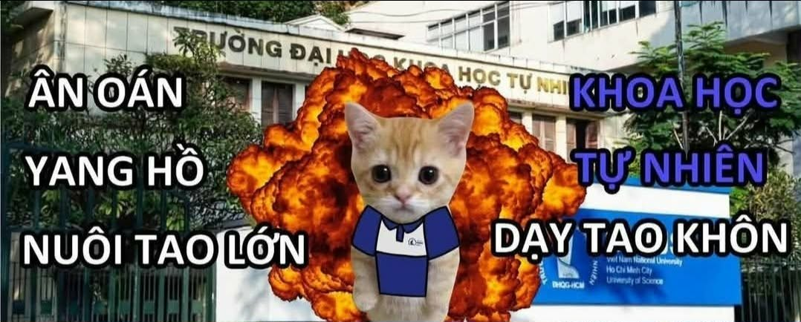

Meme Retrieval
Lê Hoàng Ân, Hoàng Tuấn Khoa, Trần Đức An, Đỗ Phan Tuấn Phát

Slide 2
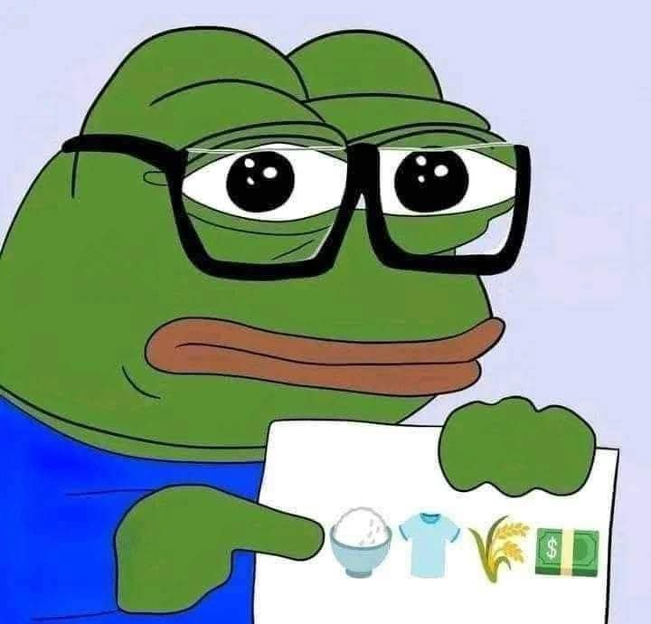
What we will present
01
02
03
04
The goal of the app
Practical use case and intuition
General strategies
General implementation

Slide 3
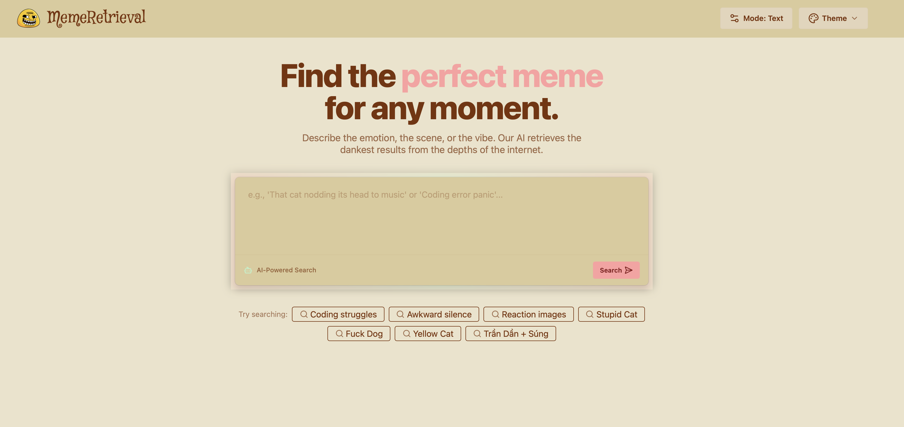
01
Goal
We want to build an app that lets people find memes (using retrieval techniques of course)

Slide 4
Use case and user intuition
02
How users want to search for that specific memes.

Slide 5
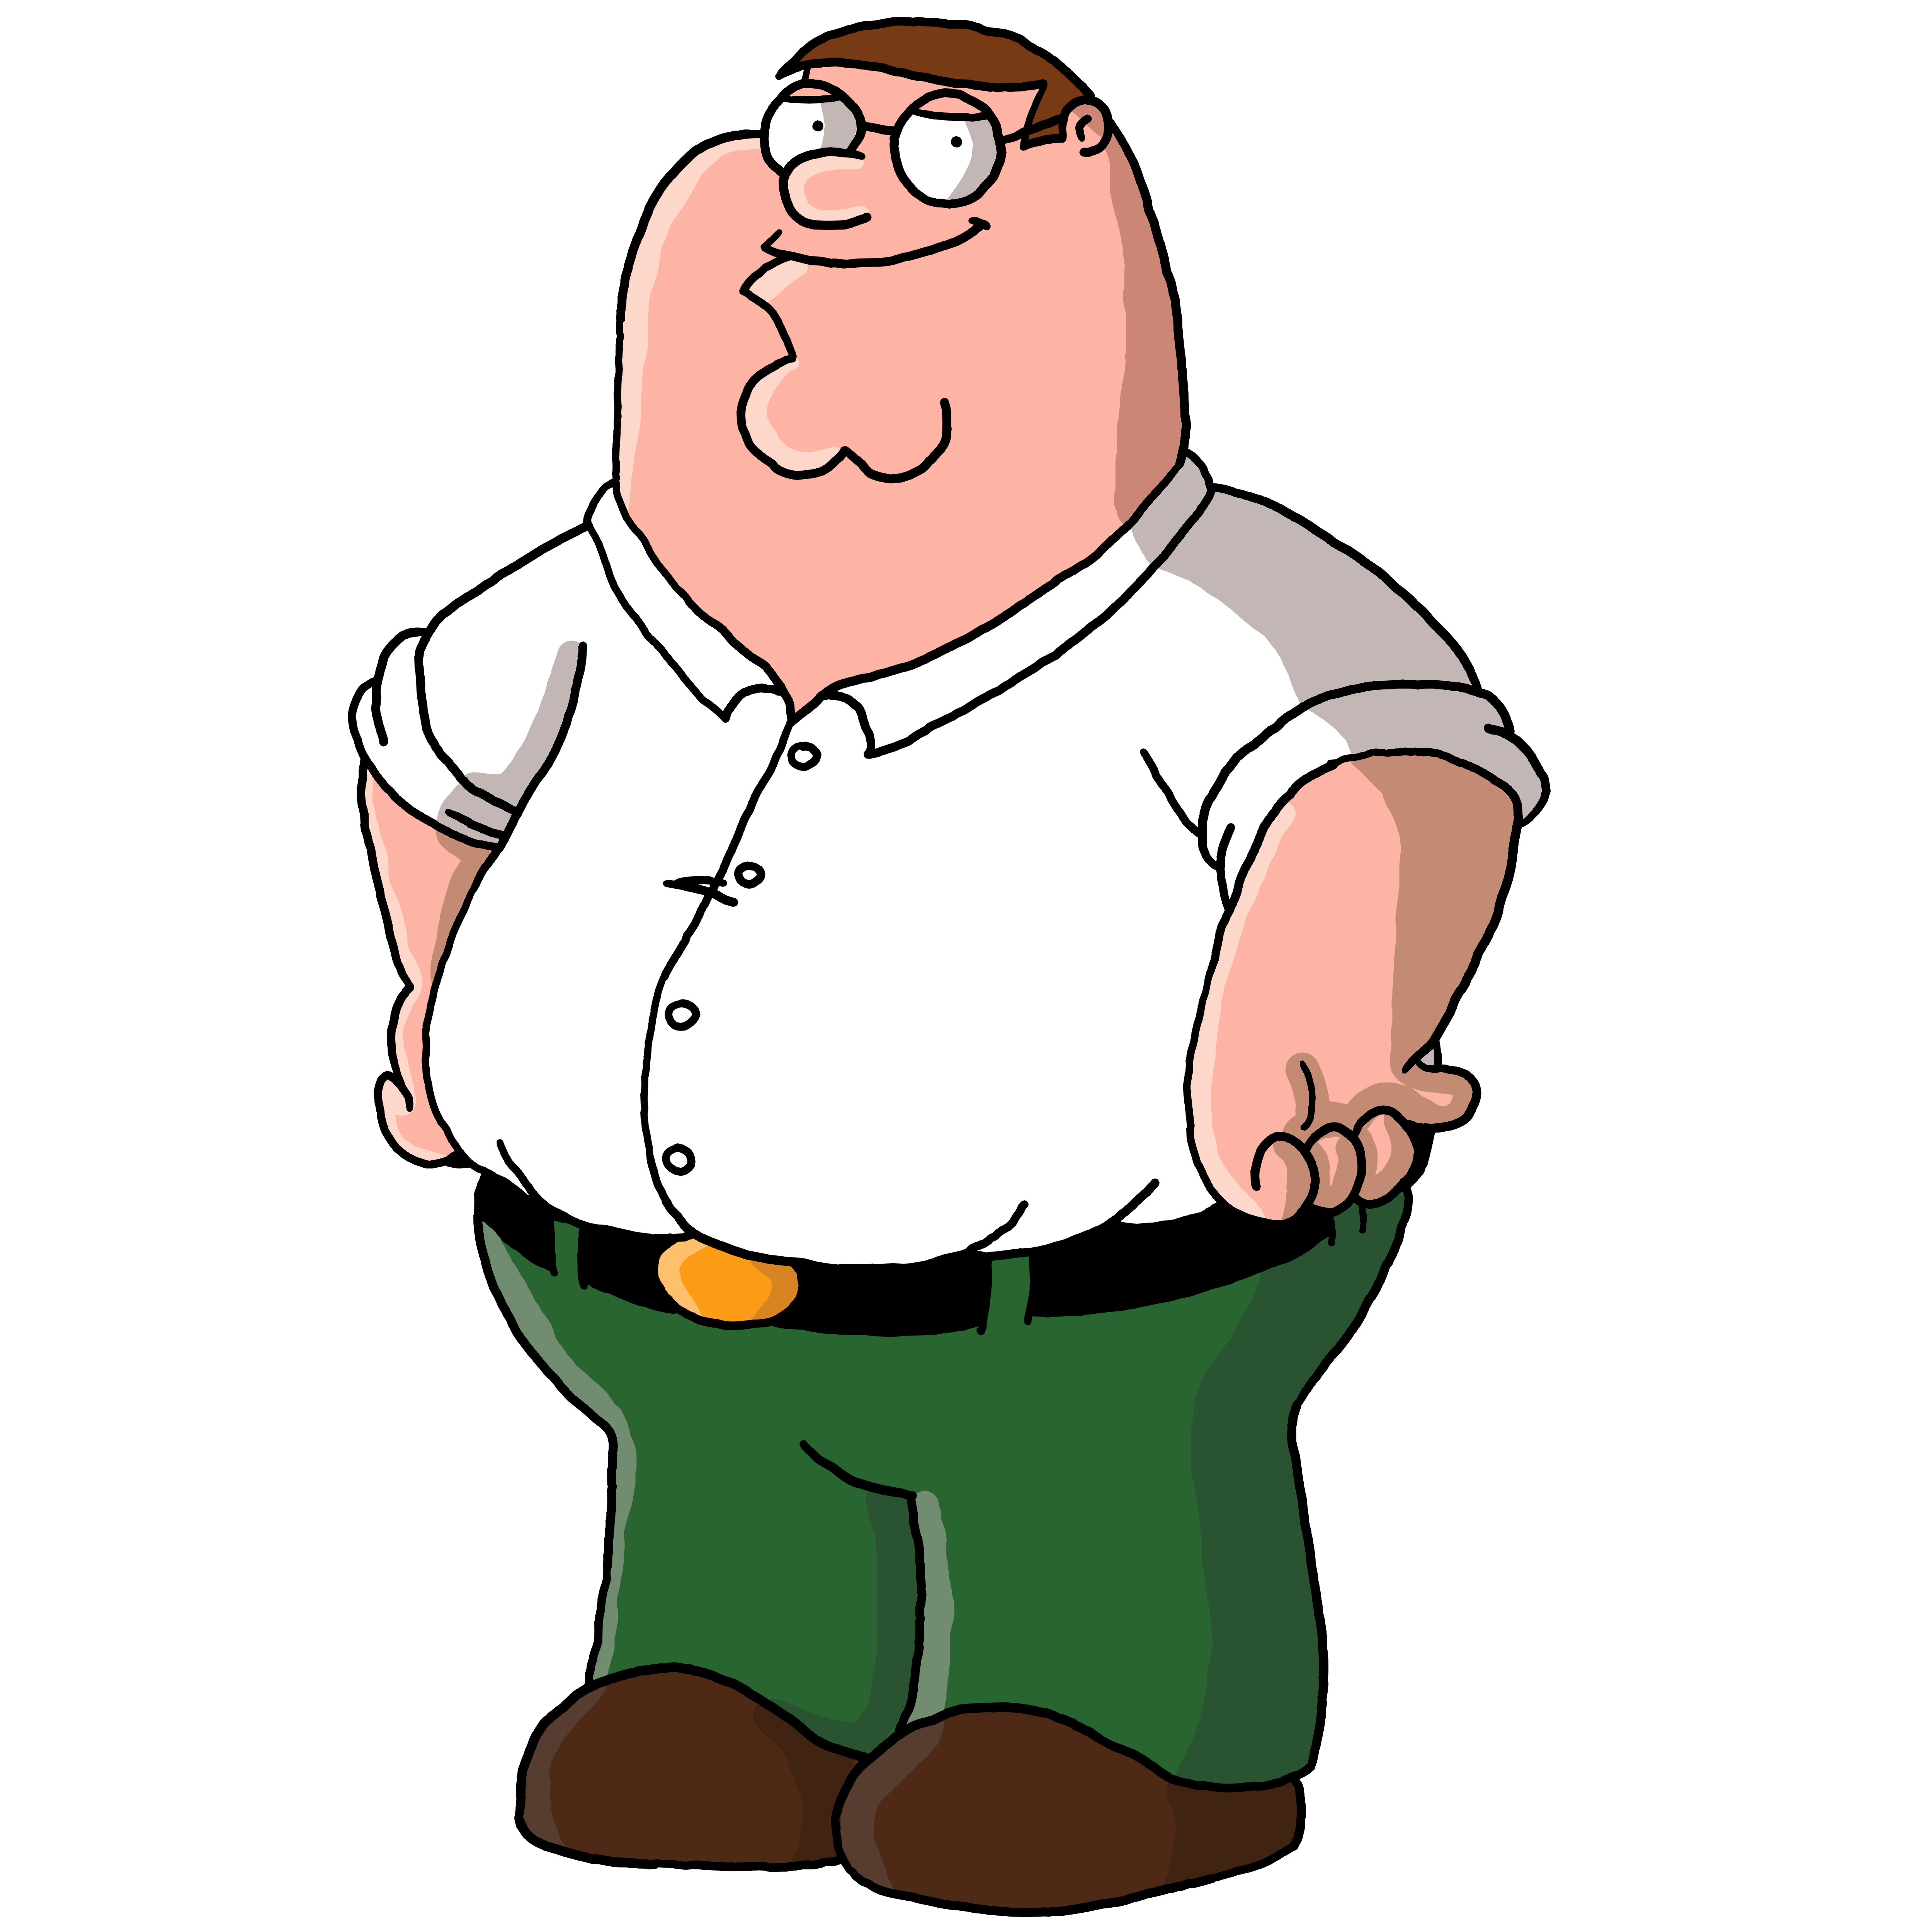
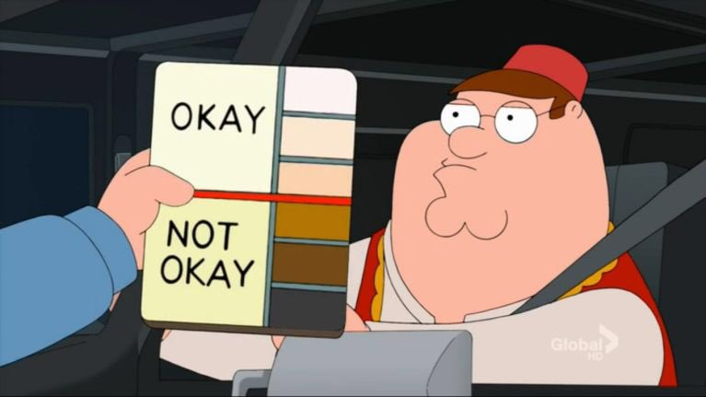
They may input some text or paste an image
1. They may search for captions or describe the meme
2. They may paste a picture of a character in the meme
“Peter Griffin racist meme”
“Peter Griffin ok not ok”

Slide 6
03
General strategies
03
How we solve the retrieval problem

Slide 7
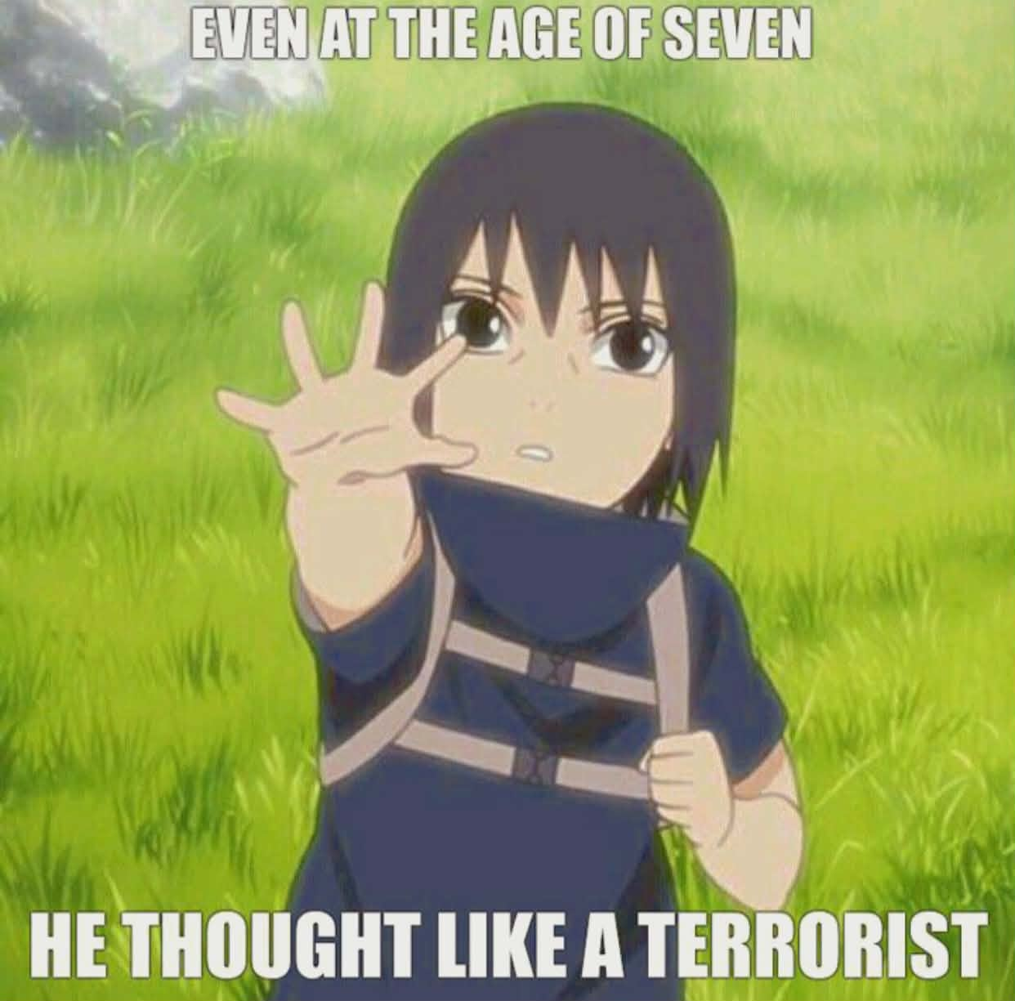




EVEN AT THE AGE OF SEVEN HE THOUGHT LIKE A TERRORIST
MEME OF CUTE ITACHI RAISING HIS HAND

Slide 8

EVEN AT THE AGE OF SEVEN HE THOUGHT LIKE A TERRORIST
Elastic Search
Text search database
We will use elastic search to find similar meme captions

Slide 9


FACE SEARCH
Vector Database for Embeddings
Chroma database
We use chroma (FAISS) to search for memes that contain similar faces.

Slide 10

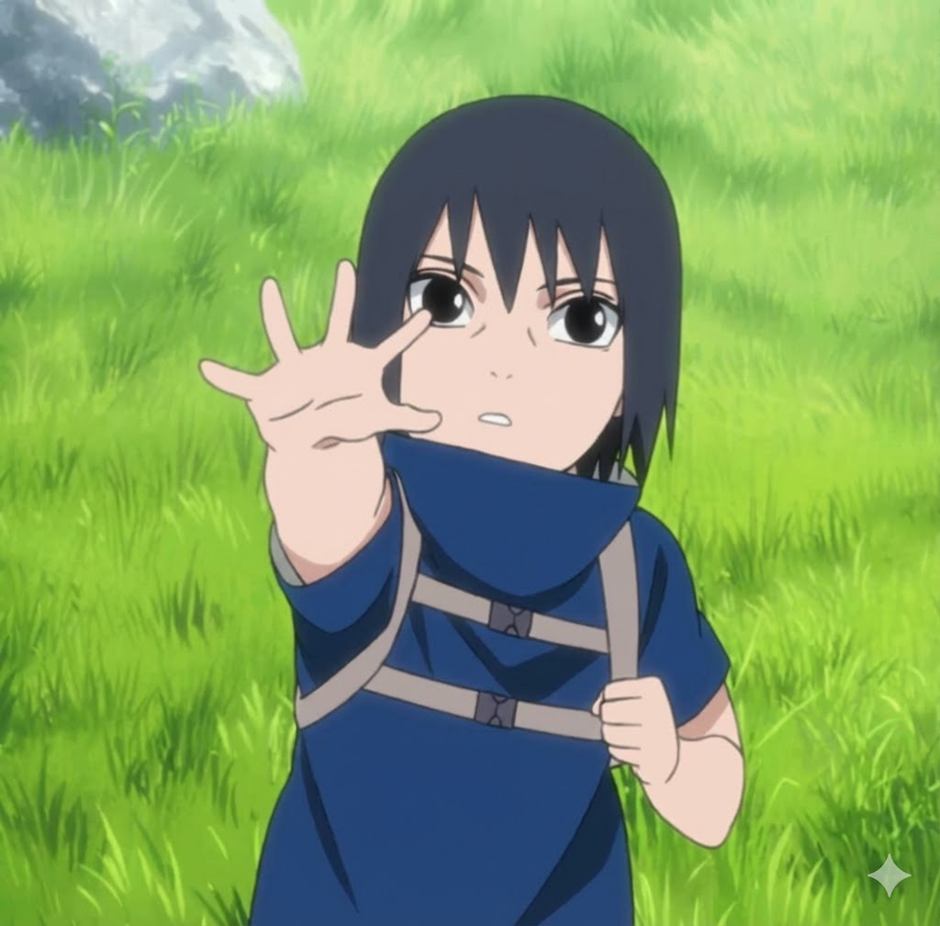
MEME OF CUTE ITACHI RAISING HIS HAND
Vector Database for Embeddings
Vector search database
We will process and embed the query, then search for memes matching description
Text removed
“MEME OF A CUTE PERSON RAISING HIS/HER HAND”

Slide 11
03
Implementation
04
03
Technical implementation

Slide 12




Use case 1: Text search
“A two-panel meme featuring characters from Game of Thrones.
Top panel: Sansa Stark looking serious, with text saying "Only a fool would trust Littlefinger."
Bottom panel: Ned Stark and Catelyn Stark standing together, smiling broadly and looking at each other.”
GliNER
Qwen2.5-1.5B-Instruct
Sansa Stark – Sophie Turner
Ned Stark - Sean Bean
Catelyn Stark - Michelle Fairley
WIKIDATA.ORG

Slide 13
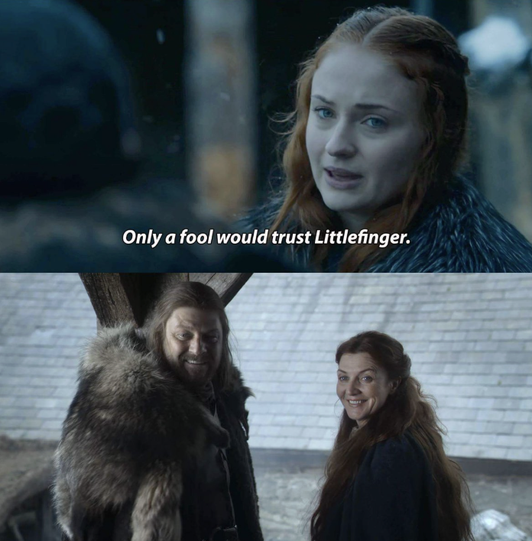

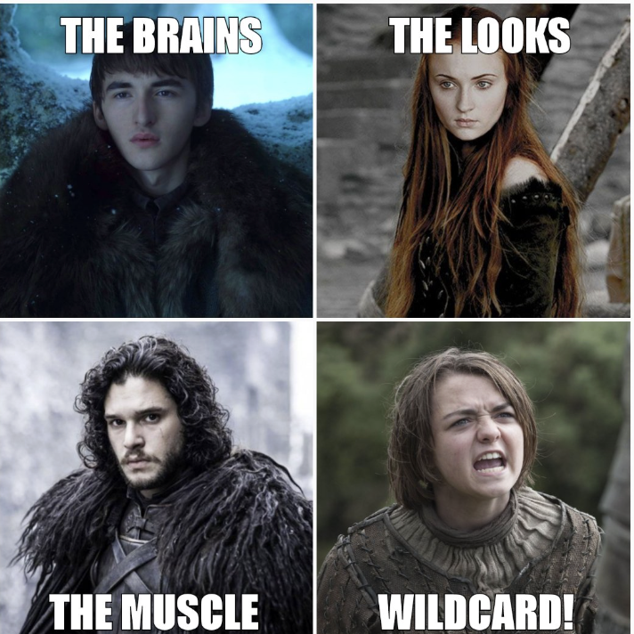
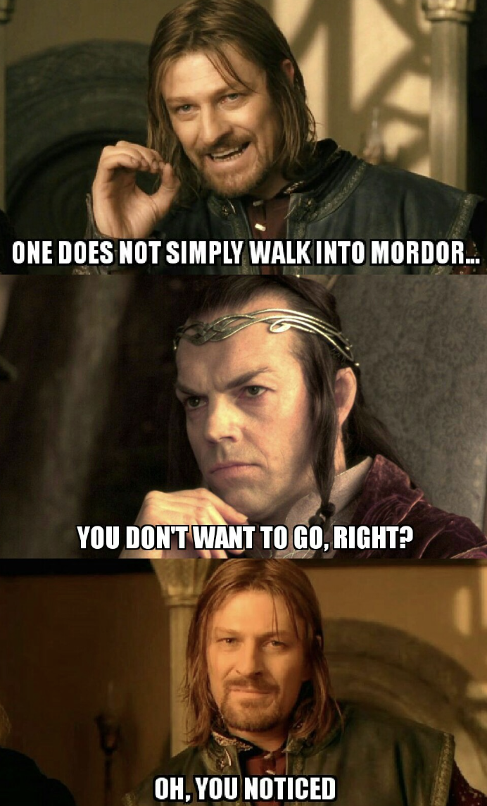


Use case 1: Text search
GliNER
Qwen2.5-1.5B-Instruct
Sansa Stark – Sophie Turner
Ned Stark - Sean Bean
Catelyn Stark - Michelle Fairley
WIKIDATA.ORG
Get face images of those celebrities (postgres+elastic search)
Chroma database (memes containing extracted faces)
ml-mobileclip

Slide 14



Use case 1: Text search
Qwen2.5-1.5B-Instruct
Prompting*
caption: Only a fool would trust Littlefinger."
descriptive text: A person looking serious, with text saying \"Only a fool would trust Littlefinger.\" A person standing together, smiling broadly and looking at each other.

Slide 15
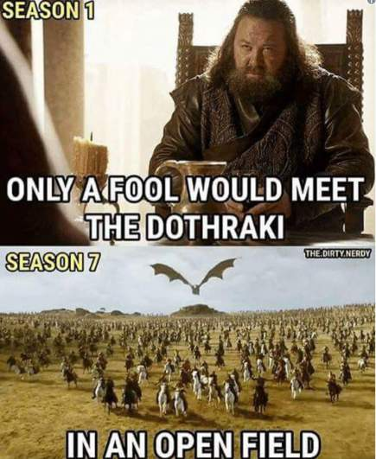
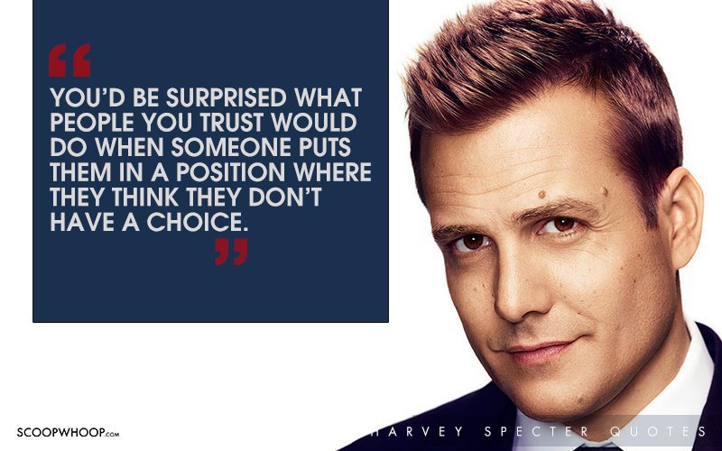



Use case 1: Text search
caption: Only a fool would trust Littlefinger."
Elastic search database (memes containing those captions)

Slide 16
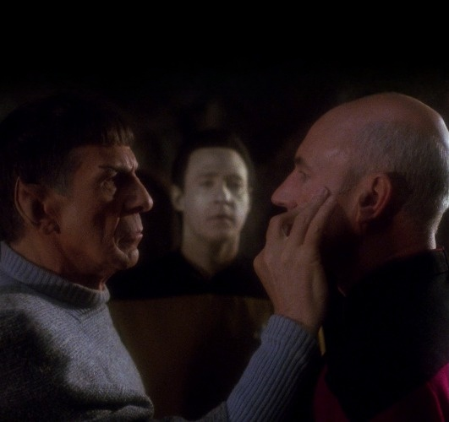
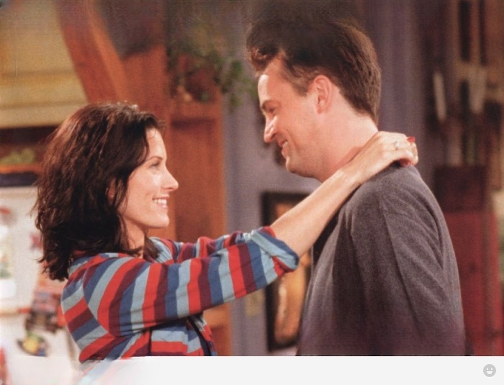
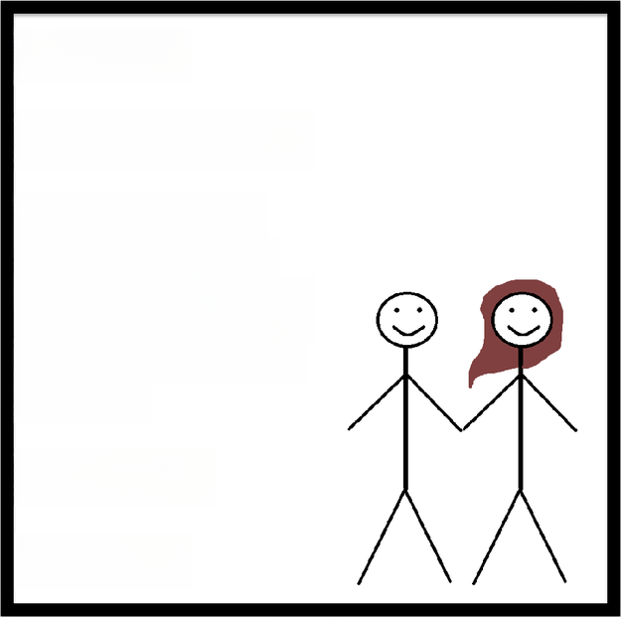
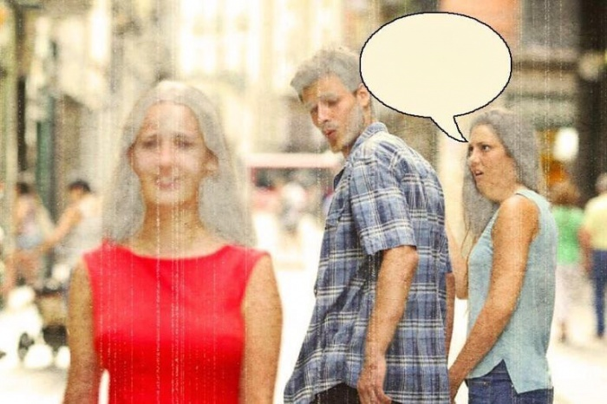

Use case 1: Text search
descriptive text: A person looking serious, with text saying \"Only a fool would trust .\" A person standing together, smiling broadly and looking at each other.
ml-mobileclip
weaviate

Slide 17
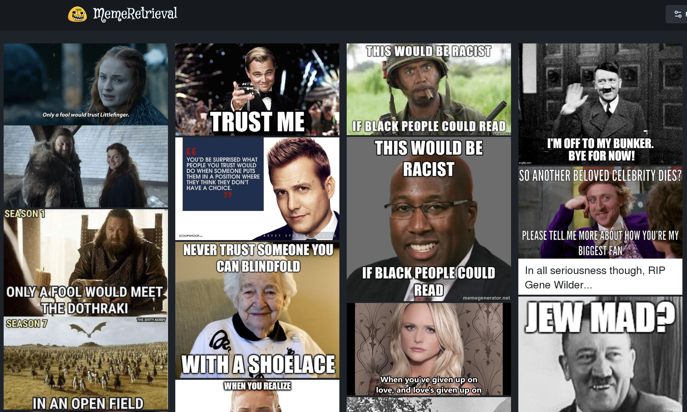


Weighted sum of scores

Slide 18
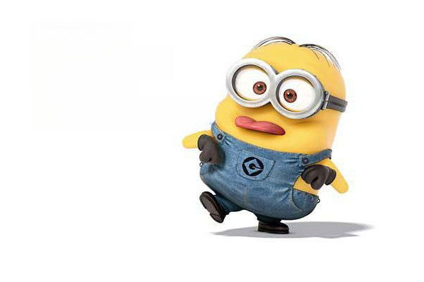



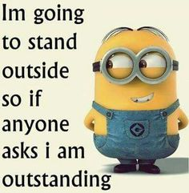
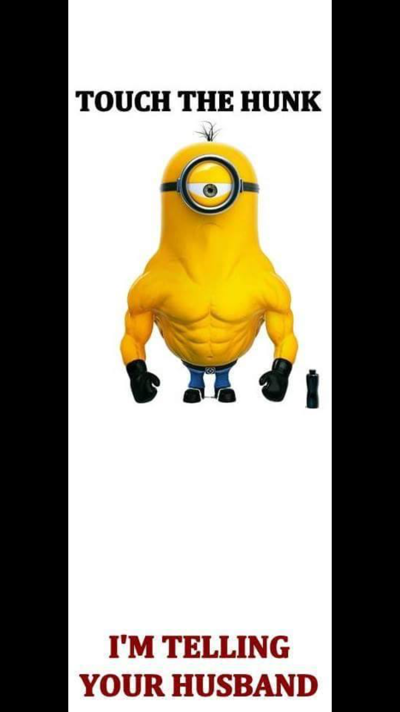





Use case 2: Image search

Slide 19
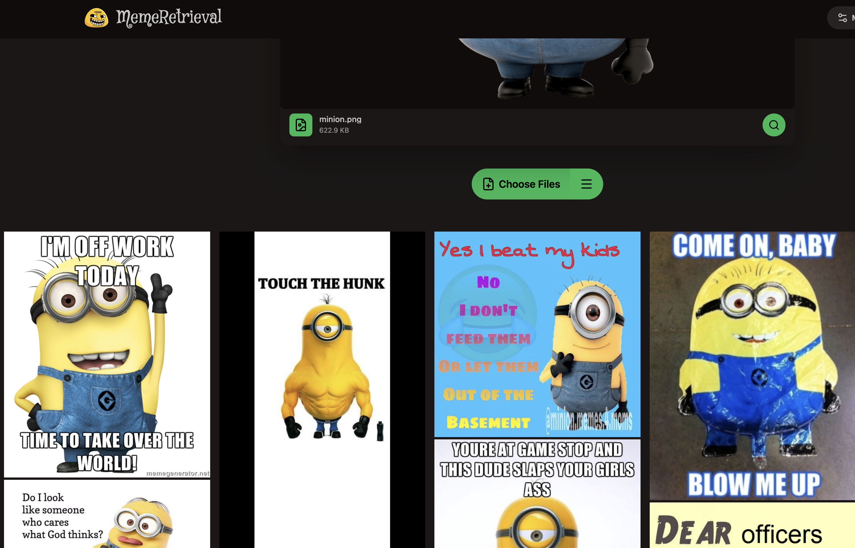

Use case 2: Image search

